Slide 1

SEGMENTATION – TESTING FOR DIFFERENCES BETWEEN GROUPS
MKTG 2341 – Week 12

Slide 2

Learning Outcomes
Understand why differences are important.
Understand the meaning of statistical significance.
Understand the most common tests of significance and when to use them:
  Chi-square
  T-tests and Z-tests
  ANOVA
2341 Wk 12 Lecture

Slide 3
Why Differences are Important
2341 Wk 12 Lecture
Notes:
NOTES (added after the lecture): consider to drop ANOVA (and possibly t-test) in the future

Slide 4
Why Differences are Important
Market Segmentation!
  Within a market, there are different types of consumers with different needs and wants.
  These differences can be the bases of marketing strategies, with the marketing mix being adjusted to best reach each segment.
2341 Wk 12 Lecture
Notes:
If we do not have differences we have no need to segment.

Slide 5
Why Differences are Important
Some differences are obvious, such as differences between teens’ and baby boomers’ clothing preferences.
Other differences are not so obvious.
Marketers who “discover” these subtle differences may take advantage of huge gains in the marketplace.
2341 Wk 12 Lecture

Slide 6
Variables Used to Segment Markets
Demographic
  Sex
  Age
  Income
  Occupation
  Education
  Ethnic background
  Family life cycle
Psychographic
  Attitudes
  Opinions
  Interests
  Motives
  Lifestyles
Behavioural
Product-usage characteristics:
  usage rate
  benefits sought
Geographic
  Location
  Accessibility
  Climate
  Density
  Resources
2341 Wk 12 Lecture

Slide 7

Segmentation
Let’s look at one example of a well-known company and its most important market segment…
2341 Wk 12 Lecture

Slide 8
Segmentation
Starbucks focuses on what it calls its “core customers”.
Who do you think they are?
  college educated
  average age of 42
  average income of $90k.
2341 Wk 12 Lecture
Notes:
Note: after the ‘who do you think they are’ bullet, stop and let the students come up with their own ideas, then show them the last three bullets

Slide 9
Why was this group chosen?
In their market research, Starbucks found a relationship between:
Age
Education
Income
Expected Expenditure @ Starbucks
&
2341 Wk 12 Lecture

Slide 10




Market Segmentation
What market segments do you think the following companies have targeted?
2341 Wk 12 Lecture
Notes:
Note: show each company name separately

Slide 11
Important Characteristics of Differences
2341 Wk 12 Lecture
Notes:
NOTES (added after the lecture): consider to drop ANOVA (and possibly t-test) in the future

Slide 12
Important Characteristics of Differences
Differences must be:
statistically significant
meaningful
stable
actionable
Statistical issue – we use specific data analyses to decide
Not statistical issues – judgment call by the marketing manager
2341 Wk 12 Lecture

Slide 13
Statistically Significant Differences
Differences must be statistically significant to be trusted.
2341 Wk 12 Lecture

Slide 14
Statistically Significant Differences
These are differences found in our sample that may be assumed to exist in the population from which our random sample was drawn.
2341 Wk 12 Lecture

Slide 15
Statistically Significant Differences
If a difference is significant we say:
  the differences observed in the data are due to real variations in the sample and, therefore, they can be projected to the whole population.
If a difference is not significant we say:
  the differences observed in the data are due to chance variations in the sample.
2341 Wk 12 Lecture

Slide 16
Meaningful Differences
Differences must be meaningful.
2341 Wk 12 Lecture

Slide 17
Meaningful Differences
Meaningful difference:
  A difference that the marketing manager can use as a basis for marketing decisions.
  The difference must be large enough to warrant separate marketing strategies for each segment.
2341 Wk 12 Lecture

Slide 18
Meaningful Differences
Meaningful difference:
  A difference can be statistically significant but not meaningful.
  Observation of differences that are not meaningful is common when working with large sample sizes.
2341 Wk 12 Lecture

Slide 19

Meaningful Differences
Let’s look at an example of a ‘spurious’ finding that is statistically significant…
Remember the Mustel Group ‘Happiness Survey’?
2341 Wk 12 Lecture

Slide 20
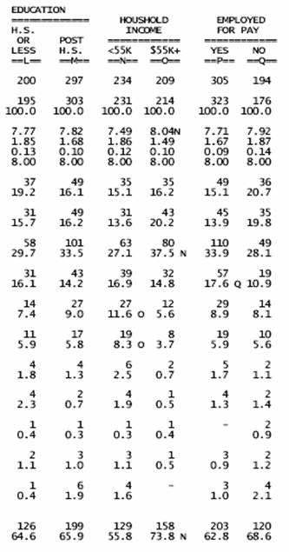
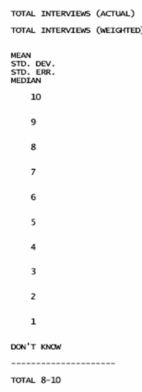
The difference between the means is what is important.
Significant difference, but essentially meaningless.
2341 Wk 12 Lecture
Notes:
This question asked respondents to rate their level of happiness using a ten-point scale on which 1 meant very unhappy and 10 meant very happy

Slide 21
Meaningful Differences
Meaningful difference:
  The larger your sample (and sub-sample) sizes, the more statistically significant findings you will generally find.
  This means that you have to be especially careful not to report findings that are meaningless to your client and/or the study objectives.
2341 Wk 12 Lecture

Slide 22
Stable Differences
Differences must be stable.
2341 Wk 12 Lecture

Slide 23
Stable Differences
Stable difference:
  A difference that will be in place for the foreseeable future.
  If the difference is only temporary or short-term, you likely do not want to spend money designing products and/or services that cater only to those differences.
  E.g., differences based on demographics that are quickly changing
2341 Wk 12 Lecture

Slide 24
Actionable Differences
Differences must be actionable.
2341 Wk 12 Lecture

Slide 25
Actionable Differences
Actionable difference:
  An actionable difference is one that you (or your client) can act upon. Even if significant, a difference may be too difficult, expensive or time-consuming to pursue.
2341 Wk 12 Lecture

Slide 26
Actionable Differences
Actionable difference:
  Actionable differences are those that allow us to identify clear, real, and meaningful market segments.
  They allow marketers to develop specific marketing strategies and tactics that best resonate with the needs and wants of those market segments.
2341 Wk 12 Lecture

Slide 27
Actionable Differences
Questions to ask yourself:
  Is the target market sufficiently defined? (Does the research really tell me who I should be trying to market to?)
  Is the target market large enough to warrant a separate marketing strategy?
  Can our company properly meet the needs of this segment?
2341 Wk 12 Lecture

Slide 28
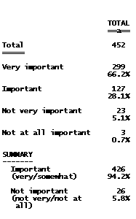
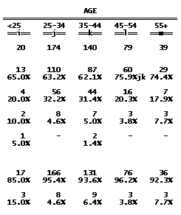
Not actionable – don’t bother reporting this difference.
2341 Wk 12 Lecture
Notes:
Explain that the significant difference is only between the 75.9% in column ‘l’ and the percentages reported in columns ‘j’ and ‘k’, not between ‘l’ and either of ‘i’ or ‘m’.

Slide 29

The Difference Between Statistical Significance and Practical Significance
Statistical significance refers to a result (e.g., difference or relationship) that is unlikely to have occurred by chance.
Practical significance means that the result has a managerial application – that is, that someone can act on the findings.
2341 Wk 12 Lecture

Slide 30
The Difference Between Statistical Significance and Practical Significance
Statistical significance does not tell us anything about how important a difference is.
Researchers must first find a significant difference, and if managers determine that the difference is important and useful, then it has practical significance.
2341 Wk 12 Lecture

Slide 31
Analyzing Data to
Identify Differences
2341 Wk 12 Lecture
Notes:
NOTES (added after the lecture): consider to drop ANOVA (and possibly t-test) in the future

Slide 32
Three Ways a Researcher Can Analyze for Differences
Compare the answer to a question, such as income, between two groups such as men versus women.
Compare the answer to one question between categories of another question, such as comparing income (one question) between three or more categories of another question such as education level (i.e. high school graduates, community college graduates, or university graduates).
2341 Wk 12 Lecture

Slide 33
Three Ways a Researcher Can Analyze for Differences
Compare the answer to one question with the answer to another question, such as comparing the amount persons would be willing to pay for concert A ticket versus the amount they would be willing to pay for Concert B ticket.
2341 Wk 12 Lecture

Slide 34
Statistical Significance
Let’s look in more detail at…
2341 Wk 12 Lecture
Notes:
NOTES (added after the lecture): consider to drop ANOVA (and possibly t-test) in the future

Slide 35
Statistical Significance
The Marketing Manager wants to trust that the segments they will be marketing to are based on real rather than chance differences.
The Researcher uses tests of significance to determine this.
2341 Wk 12 Lecture

Slide 36
What is Statistical Significance?
The concept of significance is based on:
  Expected value is assuming that there is no difference in the way members of the groups under consideration respond to our question (referred to as the “Null Hypothesis H₀)
  Observed value is what we found in the data.
2341 Wk 12 Lecture

Slide 37
What is Statistical Significance?
If there is a big difference between the expected and the observed data we:
  Reject the null hypothesis (reject that there is no significant difference)
  Conclude that the difference is significant
  Trust that the data show a real difference between groups.
2341 Wk 12 Lecture

Slide 38
What is Statistical Significance?
The expected counts (assuming no differences)
The counts that were observed in your survey
Vs.
 | Male | Female
Own iPod | 57% | 57%
Do not own | 43% | 43%
Total | 100% | 100%
 | Male | Female
Own iPod | 67% | 48%
Do not own | 31% | 52%
Total | 100% | 100%
Tests of significance determine if the observed differences are statistically significant.
2341 Wk 12 Lecture

Slide 39
Tests for Statistical Significance
2341 Wk 12 Lecture

Slide 40
Tests for Statistical Significance
There are a number of tests for significance, including:
  Chi-square
  t-Test
  Z-test
  ANOVA
2341 Wk 12 Lecture

Slide 41
Tests for Statistical Significance
The test we use depends on:
  The level of measurement of the variables (i.e., ‘categorical’ - nominal, ordinal or ‘metric’ - interval or ratio).
  The sample size.
  The number of groups being compared.
2341 Wk 12 Lecture

Slide 42
Testing for Significant Differences Between Two Groups
If the question uses a categorical scale, we will be comparing percentages between the two groups.
If the question uses a metric scale, we will be comparing averages between the two groups.
2341 Wk 12 Lecture

Slide 43
Tests for Statistical Significance
Independent Variable➔ Dependent Variable⬇ | Categorical Variable (2 categories | Categorical Variable (>2 categories) | Metric Variable
Categorical Variable (2+ categories) | Cross-tabulation & Chi-square | Cross-tabulation & Chi-square | Correlation
Metric Variable | T-test or Z-test | ANOVA | Correlation
2341 Wk 12 Lecture

Slide 44
Critical Values
Each test for significance generates a critical value that is identified by a unique character.
TEST | CRITICAL VALUE
Chi-square | χ²
T-test | t
Z-test | Ζ
ANOVA | F
2341 Wk 12 Lecture

Slide 45
Critical Values
The critical value is calculated using the data from the 2 variables of interest in our research.
The critical value is compared to a table value to conclude if the difference between 2 variables is statistically significant or not.
Note: most data analysis programs do this for you!
2341 Wk 12 Lecture

Slide 46
Critical Values
Associated with the critical value is a ‘p’ value which stands for probability…
  … of supporting the null hypothesis (no difference between groups).
      or, in other words…
  that the differences noted in the data are real and not due to chance.
2341 Wk 12 Lecture

Slide 47
Calculating Probability Values
First, we MUST determine the amount of sampling error we are willing to accept and still say the results are significant.
Convention is 5% (0.05), also known as the “alpha error” – this equates to the 95% confidence interval.
2341 Wk 12 Lecture

Slide 48
Calculating Probability Values
P values are often identified with abbreviations such as “Sig.” or “Prob.”
P values range from 0 to 1.0.
If the probability of supporting the null hypothesis is low (0.05 or less) we have significance!
2341 Wk 12 Lecture

Slide 49
Meaning of P Values
P=0.05…
P=0.01…
P=0.10…
P=0.051…
P=0.99…
significant
significant
not significant
not significant
not significant
2341 Wk 12 Lecture

Slide 50
Independent Sample t-Test
Compare means from 2 separate groups
When your samples contain 30 or more cases each, use the Z-test.
When your samples contain less than 30 cases each, use the t-Test.
2341 Wk 12 Lecture

Slide 51
Testing for Differences Between Two Percentages
2341 Wk 12 Lecture

Slide 52
Testing for Differences Between Two Percentages
Equations differ due to the use of an interval or ratio (metric) scale.
REMEMBER
Percentages are calculated for categorical questions (nominal or ordinal level of measurement).
2341 Wk 12 Lecture

Slide 53

Testing for Differences Between Two Percentages
RULE OF THUMB
Sig.(two tailed)
  p must be < 0.05
Check the p value in the data output
2341 Wk 12 Lecture

Slide 54
Testing for Differences Between Two Percentages
We use the sub-script to identify the percentage value for the different groups:
  p₁ is the percentage for segment 1
  (e.g. the percentage of males drinking soft drinks)
  p₂ is the percentage for segment 2
  (e.g. the percentage of females drinking soft drinks)
2341 Wk 12 Lecture

Slide 55
Testing for Differences Between Two Percentages
Null hypothesis H₀:
  no difference between the means being compared
  p₁ = p₂
Alternative hypothesis H_{a}:
  a true difference between the compared means
  P₁ ≠ p₂
2341 Wk 12 Lecture

Slide 56

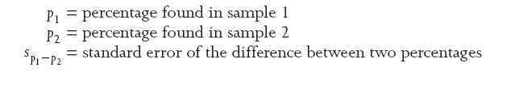
Testing for Differences Between Two Percentages
Formula for significance of the difference between two percentages:
Intuitively think of the standard error to measure how widely the difference between the two groups is spread out.
2341 Wk 12 Lecture

Slide 57
Testing for Differences Between Two Percentages
So, if the calculated z value is greater than +/– 1.96:
  We can ‘reject’ the H₀
We conclude:
  There is a real difference between the two percentages.
Graphically we can show this as > > >
2341 Wk 12 Lecture
Notes:
NOTE:
There is a theoretical difference between “can not accept” and “reject” H₀.
However, in applied business research this distinction is often ignored.

Slide 58
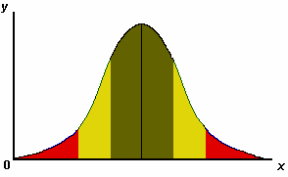
Testing for Differences Between Two Percentages
2.5%
2.5%
-1.96
+1.96
95%
H₀ Not Supported
H₀ Not Supported
H₀ Supported
p₁ < p₂
p₁ > p₂
2341 Wk 12 Lecture
p₁ = p₂

Slide 59
Using XLDA to Determine Significance of Differences Between Two Percentages
2341 Wk 12 Lecture

Slide 60
Using XLDA to Determine the Significance of the Difference Between Two Group Percentages
You must select a grouping variable: as the variable to identify the groups to be compared.
The target variable: is the variable on which the groups will be compared.
Select
  Compare
    2 groups percent
2341 Wk 12 Lecture

Slide 61
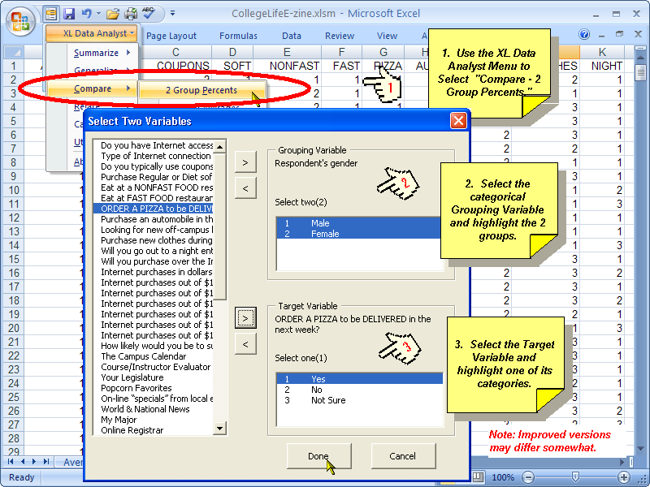
Using XLDA to Determine the Significance of the Difference Between Two Group Percentages
2341 Wk 12 Lecture

Slide 62
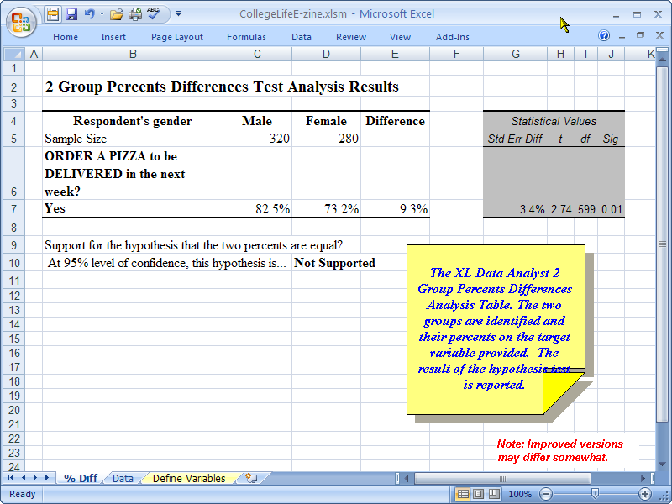
Using XLDA to Determine the Significance of the Difference Between Two Group Percentages
2341 Wk 12 Lecture

Slide 63
Testing for Differences Between Two Averages (Means)
2341 Wk 12 Lecture

Slide 64
Differences Between Averages for Two Groups
If our question has a metric scale we may summarize the question using the average.
We can test for significant differences between two groups, such as males versus females, on our metric scaled variable.
2341 Wk 12 Lecture

Slide 65
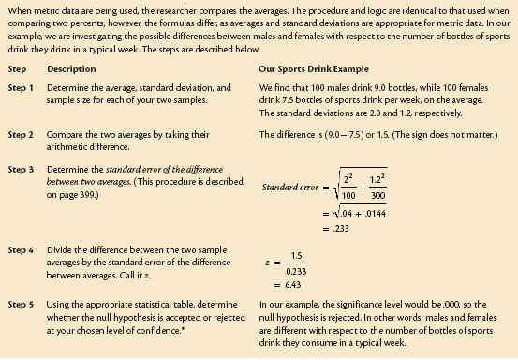
How to Determine If One’s Group’s Average Is Different from Another Group’s Average
2341 Wk 12 Lecture

Slide 66
Using XLDA to Determine the Significance of the Difference Between Two Group Averages
Select the categorical variable as the grouping variable.
Select the metric variable as the target variable.
Select
  Compare
    Group averages
2341 Wk 12 Lecture

Slide 67
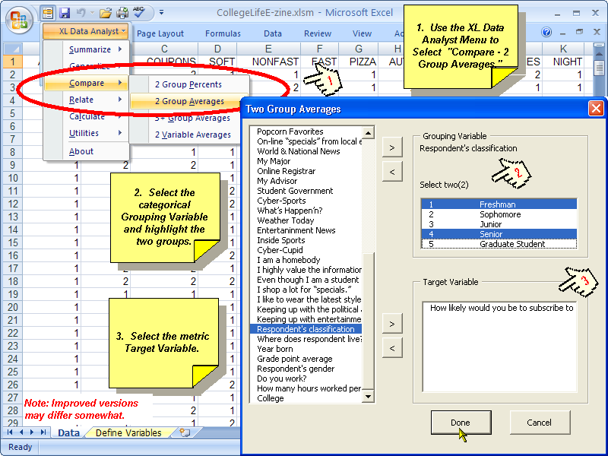
Using XLDA to Determine the Significance of the Difference Between Two Group Averages
2341 Wk 12 Lecture

Slide 68
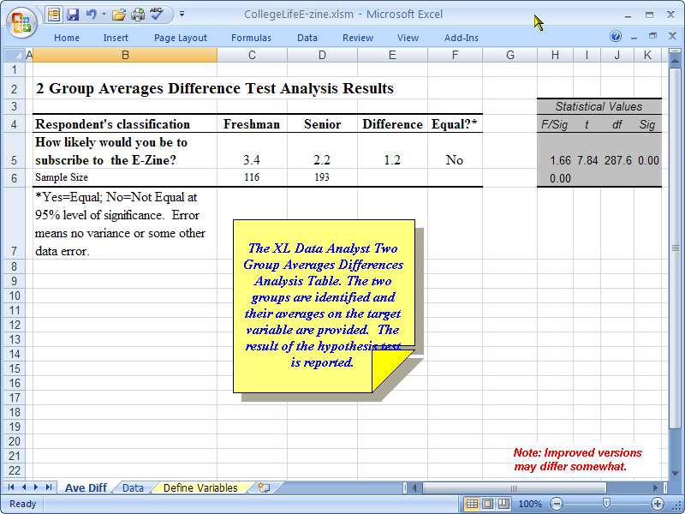
Using XLDA to Determine the Significance of the Difference Between Two Group Averages
2341 Wk 12 Lecture

Slide 69
End of Part I
2341 Wk 12 Lecture

